Slide 1


VEMANA INSTITUTE OF TECHNOLOGY Koramangala, Bengaluru-34. Department of Computer Science and Engineering Project Phase-I Review 2
Batch No. 25 - NETWORK MONITOR
By
PAVITHRA K – 1VI17CS071
RAJASHREE – 1VI17CS114
Under the Guidance of
Mr. NOOR BASHA,
Asst. Professor Department of CSE,
Vemana Institute of Technology

Slide 2
BIRD VIEW
2020 - 21
Network Monitor
Introduction
Literature Survey
Comparative analysis of the survey
Problem Statement
Design Methodology
System Specification
Module Description
Expected outcome
Plan of action for the project
References
1

Slide 3
INTRODUCTION
2020 - 21
Network Monitor
Network Monitor is a scripted tool that alerts the User about various status changes and updates such as Reachability, Firmware version changes, Issues, Resource usage, Device Information and so on .
Alerts can be sent through various modes such as GUI, Email, SMS .
Various Protocols are used for obtaining these information such as ICMP, ARP, LLDP, SNMP and so on.
The various devices are supported by the system such as Servers, Routers, Switches, Virtual Machines, IoT Devices, Cloud Instances, Data Stores, Wireless Access Points, Endpoint PCs, Printers, Mobiles and so on.
2

Slide 4
LITERATURE SURVEY - 1
2020 - 21
Network monitor
[1] Network Monitoring System for Network Equipment Availability and Performance Reporting –by Baphumelele Masikisiki, Siyabulela Dyakalashre[2020]
It describes availability and performance of a network, reporting with UFH being used as a test platform. This system is meant to help network administrators with troubleshooting network devices because it will tell them exactly where to go in order to fix the network.
Advantage and Disadvantage
It used to test the availability and performances.
The limitation of reporting notifications with alarms were not successfully implemented .
3

Slide 5
Network monitor
2020 - 21
[2] Architecture of a Network Performance Monitor for Application Services on Multi-Clouds – by Young-min Kim, Ki-sung Lee, Jae-cheol Uhm, Si-chang Kim, and Chan-gun Lee [2018]
Rudimentary reasons for having a network performance monitor for multi-cloud environments have been illustrated with examples in this research. An architecture for such a network monitor is proposed that explains how external agents are used to connect monitor such an environment.
Advantages and Disadvantages:
The model proposed for monitoring multi clouds is flexible and is integrated using external agents.
A DBMS approach to store results for offline analysis has been proposed which would be good for non-cloud network monitoring systems as well.
4

Slide 6
2020 - 21
Network monitor
[3] Measurement-Aware Monitor Placement and Routing: A Joint Optimization Approach for Network-Wide Measurements – by Guanyao Huang, Chia-Wei Chang, Chen-Nee Chuah, and Bill Lin [2017]
A theoretical framework is proposed in this research that jointly optimizes monitor placement and dynamic routing strategy to achieve maximum measurement utility with limited monitoring resources.
Advantages and Disadvantages:
There are many implementation issues with the proposed framework that need to be addressed especially determining what routing protocols are being used.
The major take away from this research is the procedure involved in forming the base framework for a network monitoring system.
5

Slide 7
2020 - 21
Network monitor
[4] A Web-based monitor and management system architecture for enterprise virtual private network – by Ruey-Shun Chen , Change-Jen Hsu, Chan-Chine Chang [2019]
Monitoring encrypted connection gateways such as enterprise VPNs is a tedious task. This papers formulates a feasible system that can monitor VPNs and includes essential elements such as system components, operation flow and much more.
Advantages and Disadvantages:
This research is primarily localized on VPNs and encrypted gateways such as SSLVPN, Client-based VPNs and so on.
It is still dependent on external management tools in order for the enterprises to be rest assured for using the new technologies.
6

Slide 8
COMPARATIVE ANALYSIS
Reference | Technique | Advantage | Drawback
Network Monitoring System for Network Equipment Availability and Performance Reporting | SNMP | Used to Test the Performance and Availability | Memory configuration
Architecture of a Network Performance Monitor for Application Services on Multi-Clouds | Multi-Cloud | Flexible and first of its kind | Network intensive and simulated results
Measurement-Aware Monitor Placement and Routing: A Joint Optimization Approach for Network-Wide Measurements | Routing | Method to implement a framework | No Real-time analysis
A Web-based monitor and management system architecture for enterprise virtual private network | VPN | Integration of GUI with back end | Covers only VPNs
2020 - 21
Network Monitor
7

Slide 9
PROBLEM STATEMENT
Network Monitor
2020 - 21
There are many open source and commercial products which provide network monitoring facilities.
These applications provide network engineers and administrators with many features and tools to identify and examine network infrastructure.
Many of the monitoring tools available in the industry provide specific monitoring tasks which are limited for one feature.
It Implements web interface for the users to view and monitor network and server and also the terminal for viewing configurations of network devices.
8

Slide 10
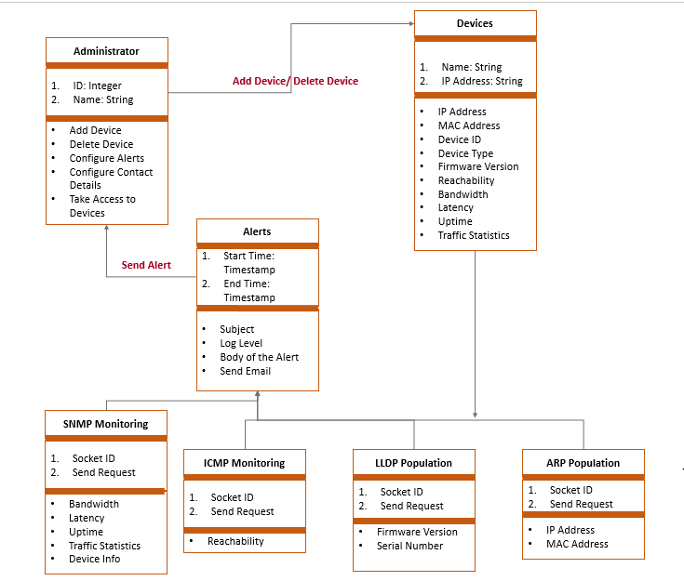
DESIGN METHODOLOGY
2020 - 21
Network Monitor
9

Slide 11
SYSTEM SPECIFICATION
2020 - 21
Network Monitor
Hardware Specifications:
Processor: Intel® Core i5 ™ CPU and above
RAM: 8 GB or higher
Hard Disk: 100 GB or higher
Software Specifications:
Operating System: Windows 10/Ubuntu 20.04 LTS
Architecture: 64-bit OS
Python 3.8 or higher
PIP Packages: RegEx, Django, Pymysql
Database: MySQL5.7 or higher
JavaScript 1.8.5 or higher
Front End: HTML5, CSS3, Bootstrap4
10

Slide 12
MODULE DESCRIPTION
2020 - 21
Network Monitor
Graphical User Interface:
This facilitates the user to login into the system, initiate the utility, whereby detail of the entire network is present in a table.
The Traffic Status will show up eventually which are obtained from the device using ICMP protocol
The user can also see all the performance attributes such as reachability, latency and so on present on any network node by switching between tabs.
Coding Languages used for this Component: HTML, CSS, Bootstrap Templates, JavaScript
Back-end Processing:
This module handles all functionality from finding the network nodes, attributes, querying with the network nodes and updating the database with information obtained through back end processing.
11

Slide 13
2020 - 21
Network Monitor
Coding Languages used for this Component: Python, Django Framework, JavaScript, pymysql framework.
Database:
This module handles acts a buffer between the backend functionality and the graphical user interface. It provides synchronization between the activities of the user and the backend
MySQL Tables used:
UserAuthentication: Deals with user login, logout, and session keys
Devices: Deals with devices and their attributes at real time
Languages used for this Component: MySQL Database, MySQL query Language, MySQL Workbench
12

Slide 14
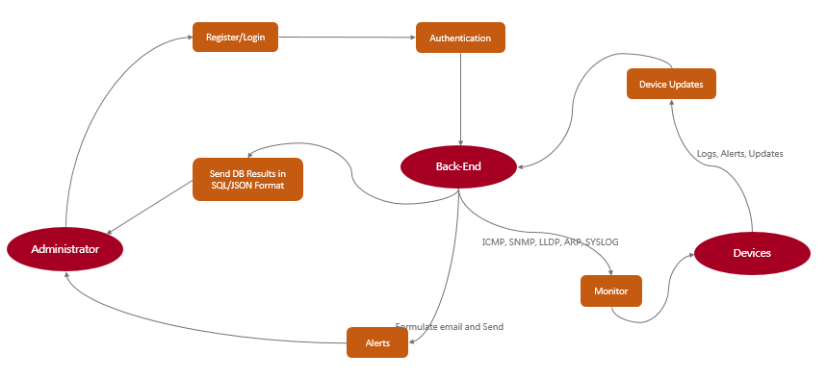
2020 - 21
Network Monitor
Data Flow Diagram for Network Monitor
13

Slide 15
2020 - 21
Network Monitor
The Administrator contains various attributes such as ID, Name and so on which are needed to login to the Network Monitor System.
The Devices contains several attributes such as ID, Name, IP Address and so on that are used to populate database with various parameters of each device such as MAC, Address, Device ID, Device Type, Firmware Version, Reachability, Access, Bandwidth, Latency, Uptime, Traffic Statistics and so on.
The SNMP Monitoring device including Bandwidth, Latency in reaching the device, Uptime of the device, Traffic Statistics in real time and information about device.
14

Slide 16
2020 - 21
Network Monitor
The ICMP Monitoring contains attributes Send Request that are used to determine the reachability of the device.
The LLDP Population contains Send Request that are used to learn more about the device through the LLDP RX packets; firmware versions, serial number and chassis number are of interest in particular.
The ARP Population contains are mainly used to populate MAC Address and IP Address of the device into the Database.
15

Slide 17
EXPECTED OUTCOME
2020 - 21
Network Monitor
A fully functional network monitoring system that can overlay various monitoring protocols such as ICMP, SNMP, SYSLOG, ARP, LLDP and so on to obtain all information about various network nodes.
Development of easy installation script setup documentation.
A lucid, user-friendly User Interface for the application that can display information with right intensity
Consistent triggering for alerts in any inconsistent conditions that found in a network
Alerts should be sent to the users configured as per their customizations.
16

Slide 18
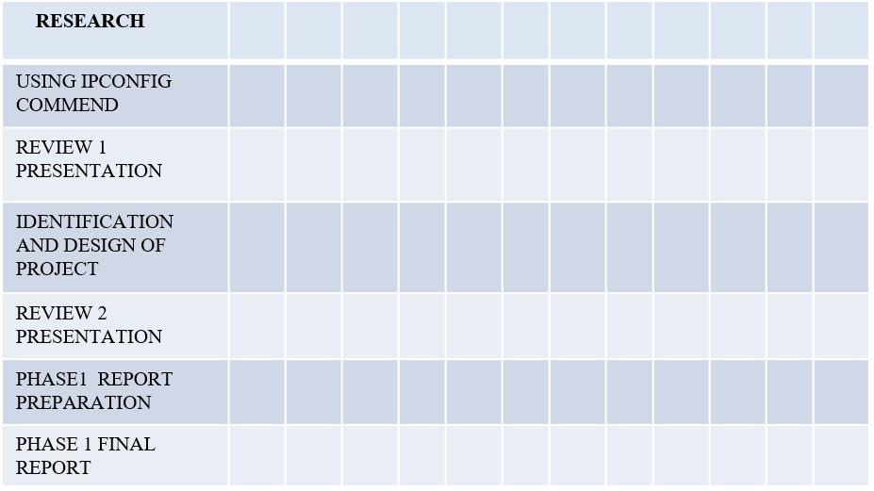
PLAN OF ACTION FOR THE PROJECT
2020 - 21
Network Monitor
TASK
SEP
OCT
NOV
DEC
JAN
17

Slide 19
REFERENCES
2020 - 21
Network Monitor
[1] Network Monitoring System for Network Equipment Availability and Performance Reporting –by Baphumelele Masikisiki, Siyabulela Dyakalashre[2020]
[2] Architecture of a Network Performance Monitor for Application Services on Multi-Clouds – by Young-min Kim, Ki-sung Lee, Jae-cheol Uhm, Si-chang Kim, and Chan-gun Lee 2018
[3] Measurement-Aware Monitor Placement and Routing: A Joint Optimization Approach for Network-Wide Measurements – by Guanyao Huang, Chia-Wei Chang, Chen-Nee Chuah, and Bill Lin 2017
[4] A Web-based monitor and management system architecture for enterprise virtual private network – by Ruey-Shun Chen , Change-Jen Hsu 2019
18

Slide 20
THANK YOU
2020 - 21
Network Monitor
19

Slide 21
TABLE OF CONTENTS
Acknowledgement | i
Abstract
List of Figures
List of Tables
1. Introduction | 1
1.1 Scope | 2
1.2 Objective | 3
2. Literature Survey | 4
2.1 Comparative Analysis | 6
3. System Requirements | 7
3.1 Functional Requirements | 7
3.2 Non-Functional Requirements | 7
3.3 Hardware Requirements | 15
3.4 Software Requirements | 15
4. Design Methodology | 16
4.1 System Architecture | 16
4.2 Design | 17
4.2.1 Use Case Diagram | 17
4.2.2 Class Diagram | 18
4.2.3 Sequence Diagram | 19
4.2.4 Data Flow Diagram | 20
5. Module Description | 23
Applications | 28
6. Summary | 29
Conclusion | 30
References | 31

